Slide 1
SIGN LANGUAGE LEARNING SYSTEM
GROUP –1
GROUP MEMBERS—
Labanya Saha(21201059)
Saumoon Jannat(21201066)
Paria Chowdhury(21201067)
Md Mehedi Islam(21201065)

Slide 2
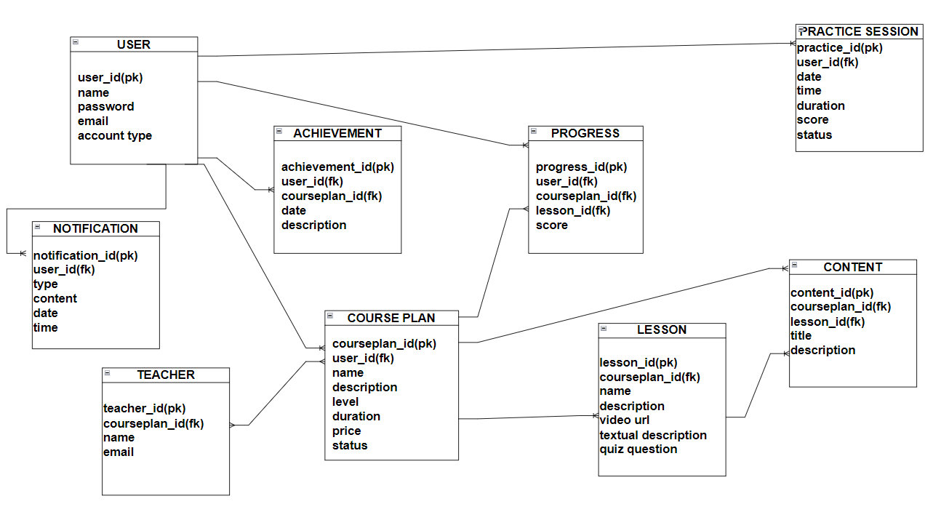
ENTITY RELATIONSHIP DIAGRAM

Slide 3
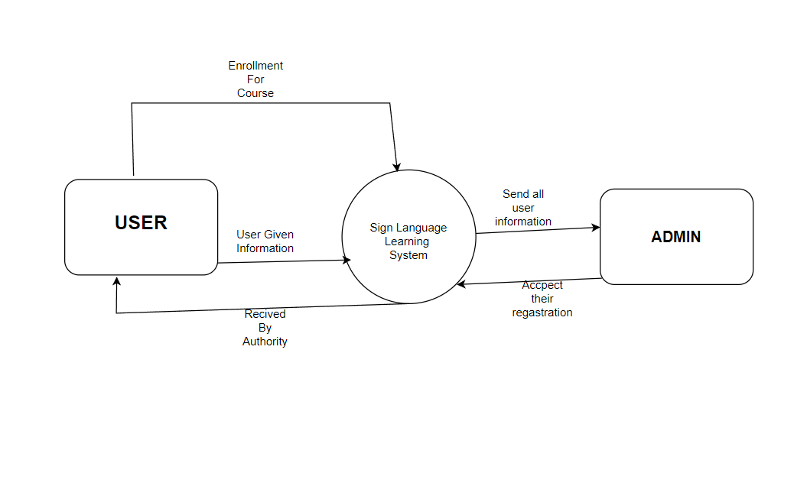
DFD 0 LEVEL

Slide 4
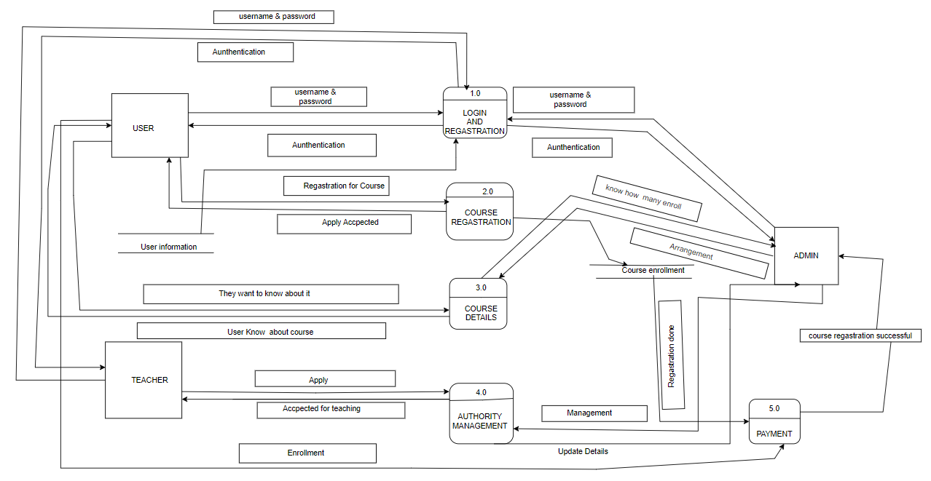
DFD-1

Slide 5
THANK YOU

